Slide 1
LITERACY IN JAMMU AND KASHMIR
By
Taseem AhmeD
ASSISTANT PROFESSOR
Department of Geography
GOVT.DEGREE COLLEGE RAJOURI
J&K

Slide 2
Introduction
The state of Jammu and Kashmir has enhanced its literacy by 40.49 percent points from 26.67 percent in 1981 to 67.16 percent in 2011 but still lags behind the national average by 5.81 percent.
Table: Jammu and Kashmir: Progress in Literacy, 1961-2011
Census Year | Literacy Rate
 | Person | Male | Female | Male-Female Gap
1981 | 26.67 | 36.29 | 15.88 | 20.41
2001 | 55.50 | 66.60 | 43.00 | 23.60
2011 | 67.16 | 76.75 | 56.43 | 20.32
Source: Census of India, 1961, 1971, 1981, 2001 and 2011.

Slide 3
Jammu and Kashmir occupies 30th position in literacy among the 35 states and union territories of India.
Jammu and Kashmir had low literacy rate as compared to its neighboring states of Punjab and Himachal Pradesh.
Table: JAMMU AND KASHMIR and Neighboring States: Literacy, 2011
State | General Literacy |  |  | Rural Literacy |  |  | Urban Literacy
 | Persons | Male | Female | Persons | Male | Female | Persons | Male | Female
J & K | 67.20 | 76.80 | 56.40 | 63.20 | 73.80 | 51.60 | 77.10 | 83.90 | 69.00
Punjab | 75.80 | 80.40 | 70.70 | 71.40 | 76.60 | 65.70 | 83.20 | 86.70 | 79.20
Himachal Pradesh | 82.80 | 89.50 | 75.90 | 81.90 | 89.10 | 74.60 | 91.10 | 93.40 | 88.40
INDIA | 73.0 | 80.9 | 64.6 | 67.8 | 77.2 | 57.9 | 84.1 | 88.8 | 79.1
Source: Census of India, 2011

Slide 4
Hill states like Mizoram, Manipur, Meghalaya, Assam, Sikkim and Uttaranchal had high literacy than Jammu and Kashmir.
Difference in the literacy rates of males and females in Jammu and Kashmir is significantly higher than all the other hill states of the country.
Table: JAMMU AND KASHMIR and other Hill States, Literacy, 2011
State | Literacy Rate (Percent)
 | Total | Male | Female | Male-Female Gap | Urban | Rural | Urban-Rural Gap
J&K | 67.20 | 76.80 | 56.40 | 20.4 | 77.10 | 63.2 | 13.9
Himachal | 82.80 | 89.50 | 75.90 | 13.60 | 91.10 | 81.9 | 9.2
Uttrakhand | 78.80 | 87.40 | 70.00 | 17.40 | 84.50 | 76.3 | 8.2
Sikkim | 81.40 | 86.60 | 75.60 | 11.00 | 88.70 | 78.9 | 9.8
A. Pradesh | 65.40 | 72.60 | 57.70 | 14.90 | 82.90 | 59.9 | 23.0
Nagaland | 79.60 | 82.80 | 76.10 | 6.70 | 89.60 | 75.3 | 14.3
Manipur | 79.20 | 86.10 | 72.40 | 13.70 | 85.40 | 76.2 | 9.2
Mizoram | 91.30 | 93.30 | 89.30 | 4.00 | 97.60 | 84.1 | 13.5
Meghalaya | 74.40 | 76.00 | 72.90 | 3.10 | 90.80 | 69.9 | 20.9
Assam | 72.20 | 77.80 | 66.30 | 11.50 | 88.50 | 69.3 | 19.2
Source: Census of India, 2011

Slide 5
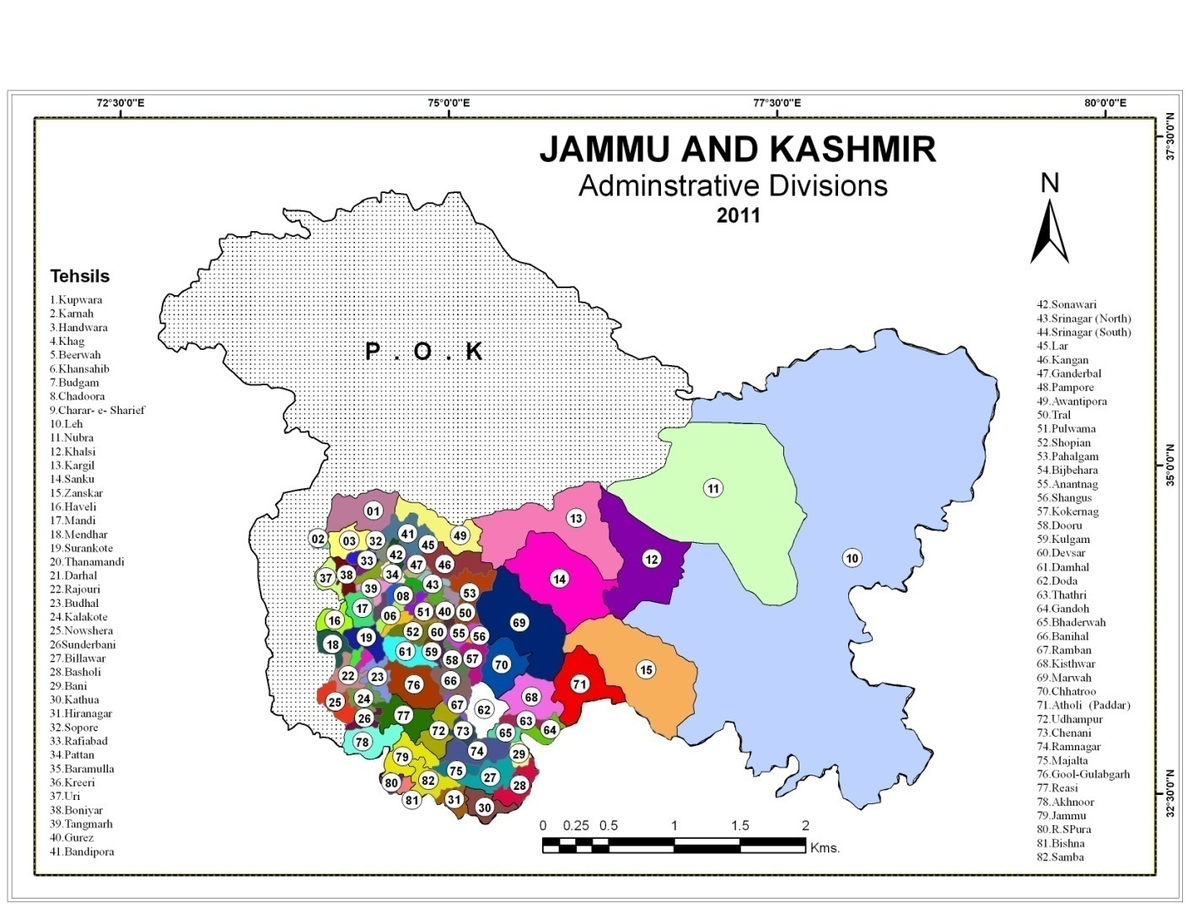

Slide 6
Trends in literacy
Literacy in Jammu and Kashmir was never above the national average during the period 1981-2011.
The literacy rate improved from 26.67 percent in 1981 to 67.16 percent in 2011. Their is an increase of 40.49 percent points over the three decades.
The rural literacy rate jumped by 41.55 percent points from 21.63 percent in 1981 to 63.18 percent in 2011.
The urban literacy increased by only 31.56 percent points from 45.56 percent in 1981 to 77.12 percent in 2011.
The male literacy moved forward by 40.46 percent points from 36.29 percent in 1981 to 76.75 percent in 2011 and among females it had gone up by 40.55 percent points from 15.58 percent in 1981 to 56.43 percent in 2011.
Gender disparity in literacy is historical phenomenon. The gap in male-female literacy was 20.41 percent points in 1981 and 20.32 percent points in 2011.

Slide 7
The rural-urban differential in literacy rate was of the order of about 23.93 percent points in 1981 and decreased considerably to 13.94 percent points in 2011.
In all the census years, Badgam district continued to record the low literacy rate. The rural as well as urban literacy rates were also low during the period 1981-2011. Jammu district, on the other hand, enjoyed the distinction of being the most literate district in the state throughout the study period.
With the spread of literacy and education, the number of districts recording high level of literacy increased in every successive census year. This increase was due to fast and rapid spread of literacy both among male and female population .

Slide 8
Jammu AND Kashmir: Change in Literacy, 1981-2011
District | Literacy in Percentage |  |  |  | Change in Literacy in Percent Points
 | 1981 | 1991* | 2001 | 2011 | 1981-91 | 1991-2001 | 2001-2011 | 1981-2011
Anantnag | 22.93 | 34.71 | 46.5 | 60.96 | 11.78 | 11.79 | 14.46 | 38.03
Pulwama | 20.47 | 35.03 | 49.6 | 62.12 | 14.56 | 14.57 | 12.52 | 41.65
Srinagar | 33.90 | 46.85 | 59.8 | 63.72 | 12.95 | 12.95 | 3.92 | 29.82
Badgam | 17.86 | 30.18 | 42.5 | 56.08 | 12.38 | 12.32 | 13.58 | 38.22
Baramulla | 20.62 | 33.01 | 45.4 | 60.45 | 12.39 | 12.3 | 15.05 | 39.83
Kupwara | 16.82 | 30.01 | 43.2 | 64.51 | 13.19 | 13.19 | 21.31 | 47.69
Kargil | 18.86 | 39.52 | 60.18 | 71.34 | 20.66 | 20.66 | 11.16 | 52.48
Leh | 25.17 | 45.23 | 65.3 | 77.20 | 20.06 | 20.07 | 11.9 | 51.83
Doda | 18.50 | 33.2 | 47.9 | 58.38 | 14.7 | 14.7 | 10.48 | 39.88
Udhampur | 23.52 | 39.36 | 55.2 | 63.32 | 15.84 | 15.84 | 8.12 | 39.80
Kathua | 31.90 | 48.75 | 65.6 | 73.09 | 16.85 | 16.85 | 7.49 | 41.19
Jammu | 42.86 | 59.93 | 77.0 | 82.43 | 17.07 | 17.07 | 5.43 | 39.57
Rajouri | 24.73 | 41.36 | 58.0 | 68.17 | 16.63 | 16.64 | 10.17 | 43.44
Poonch | 23.39 | 37.29 | 51.2 | 66.74 | 13.9 | 13.91 | 15.54 | 43.35
J&K | 26.67 | 41.08 | 55.5 | 67.16 | 14.41 | 14.41 | 11.66 | 40.49
Source: Census of India, 1981, 2001 and 2011, (1991* Averages)

Slide 9
Spatial Patterns
Two districts of the state namely Jammu with 78.24 percent and Samba with 79.93 percent remained above the national average(74.04 percent).
Out of 22 districts only six districts experienced higher literacy rate than the state average.
Out of 82 tehsils, only 13 tehsils had literacy rate higher than the national average and 20 tehsils had higher literacy rate than the state average.
Nearly two-third tehsils of the state are still struggling to catch up with the state average.
Nearly 90 percent tehsils (75) had more than half of the population as literate.
The urban tehsil of Jammu with 85.1 percent literacy had the distinction of being the most literate tehsil of the state.
At the other end of the scale, Chhatroo a rural tehsil of Kishtwar district with 45.11 percent literacy rate represents the least literate tehsil of Jammu and Kashmir.

Slide 10
JAMMU AND KASHMIR: Literacy Rate and Literacy Indicators,2011
Districts | Literacy Rate | Proportion of SC Population | Proportion of ST Population | Proportion of Urban Population | Proportion of Workers | Proportion of Population Below Poverty Line | Road Length per 100 sqkms Area | Proportion of Primary Schools
Kupwara | 64.51 | 0.12 | 8.08 | 12.03 | 26.32 | NA | 47.04 | 7.7
Badgam | 56.08 | 0.05 | 3.17 | 12.99 | 28.51 | 23.61 | 99.78 | 5.6
Leh(Ladakh) | 77.20 | 0.37 | 71.81 | 34.21 | 56.24 | 21.38 | 3.33 | 1.8
Kargil | 71.34 | 0.01 | 86.89 | 11.60 | 36.84 | 29.80 | 6.84 | 2.1
Punch | 66.74 | 0.12 | 36.93 | 8.10 | 33.85 | 29.00 | 35.60 | 4.9
Rajouri | 68.17 | 7.50 | 36.24 | 8.14 | 45.28 | 20.83 | 16.31 | 9.6
Kathua | 73.09 | 22.91 | 8.65 | 14.55 | 32.51 | 33.85 | 38.61 | 7.5
Baramula | 64.63 | 0.15 | 3.74 | 18.10 | 30.18 | 38.45 | 47.90 | 8.6
Bandipore | 56.28 | 0.10 | 19.22 | 16.66 | 38.07 | 30.80 | 76.13 | 4.2
Srinagar | 69.41 | 0.09 | 0.72 | 98.60 | 32.92 | 5.92 | 106.75 | 2
Ganderbal | 58.04 | 0.04 | 20.53 | 15.81 | 33.92 | 19.12 | 37.99 | 2.6
Pulwama | 63.48 | 0.07 | 4.03 | 14.36 | 33.62 | 22.74 | 68.60 | 4.2
Shupiyan | 60.76 | 0.02 | 8.20 | 6.15 | 32.95 | 14.37 | 163.14 | 2.1
Anantnag | 62.69 | 0.17 | 10.75 | 26.23 | 36.13 | 10.95 | 42.58 | 5.3
Kulgam | 59.23 | 0.00 | 6.25 | 18.99 | 37.69 | 25.36 | 54.17 | 2.7
Doda | 64.68 | 13.03 | 9.57 | 7.97 | 37.06 | 25.05 | 7.79 | 6.7
Ramban | 54.27 | 4.91 | 14.02 | 4.16 | 30.74 | 31.53 | NA | 2.7
Kishtwar | 56.20 | 6.20 | 16.54 | 6.44 | 35.97 | NA | 26.22 | NA
Udhampur | 68.49 | 24.97 | 10.15 | 19.50 | 43.91 | 22.55 | NA | 5.1
Reasi | 58.15 | 12.00 | 28.08 | 8.58 | 46.01 | 32.94 | 73.48 | 2.9
Jammu | 83.45 | 24.71 | 4.52 | 50.00 | 33.24 | 11.59 | NA | 8.1
Samba | 81.41 | 28.80 | 5.51 | 16.81 | 29.01 | 32.50 | NA | 2.9
J&K | 67.16 | 7.38 | 11.91 | 27.38 | 34.47 | 24.11 | 52.90 | 100
Sources: Census of India, 2011/www.jkeducation.gov.in

Slide 11
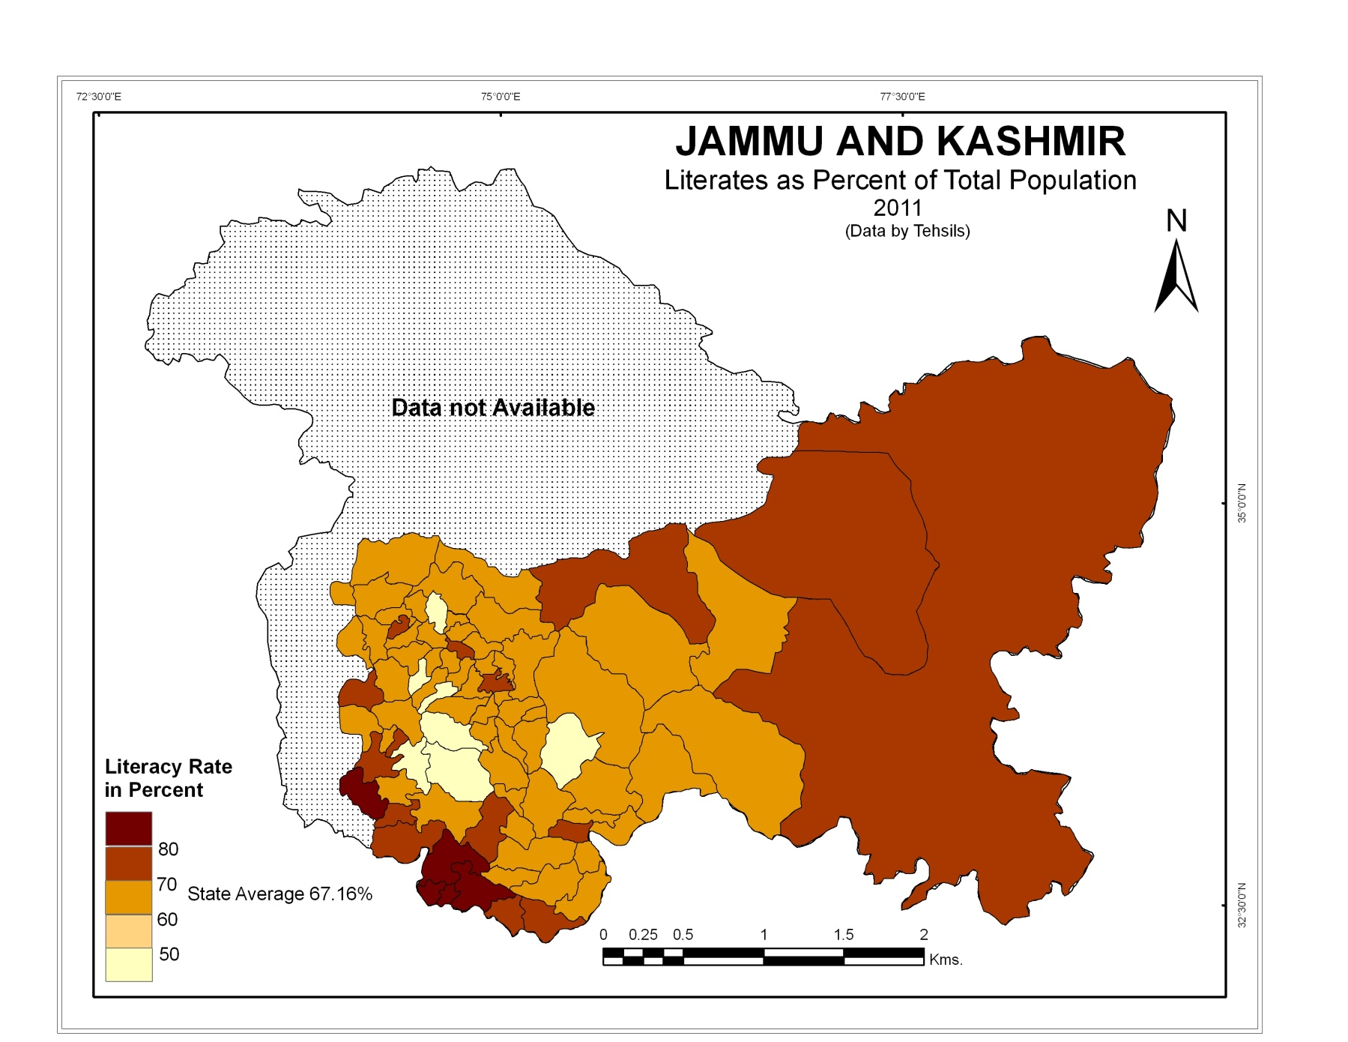

Slide 12
Broadly speaking, Map reveals that eastern and south-western parts where the literacy rates are generally high, stands out in marked contrast to central part, where low level of literacy prevails.
The highest literacy rate in south-west and east gradually decrease towards centre.
The moderate literacy is observed in the stretches of low literacy running from south-east to north-west direction.
High literacy rates are characteristic of areas with high degree of exposure to external influence, high level of Christian missionary work, high degree of urbanization and high standard of living.
On the other hand, low literacy is found in areas with backward economy, high percentage of population engaged in agriculture, low age of marriages result in high rate of dropouts, low degree of urbanization and high proportion of scheduled tribe population.

Slide 13
Male-Female Literacy
Jammu and Kashmir made remarkable progress in female literacy from 43.0 percent in 2001 to 56.43 percent in 2011 but still lags behind the national average of 64.6 percent by 8.17 percent points.
Jammu and Kashmir scored 32nd position in female literacy as compared to 30th position in overall literacy rate among all states and union territories of India.
The state with 67.16 percent literacy had 76.75 percent male literacy and 56.43 percent female literacy, according to census, 2011.
There were large spatial variations and disparities in male and female literacy in Jammu and Kashmir.

Slide 14
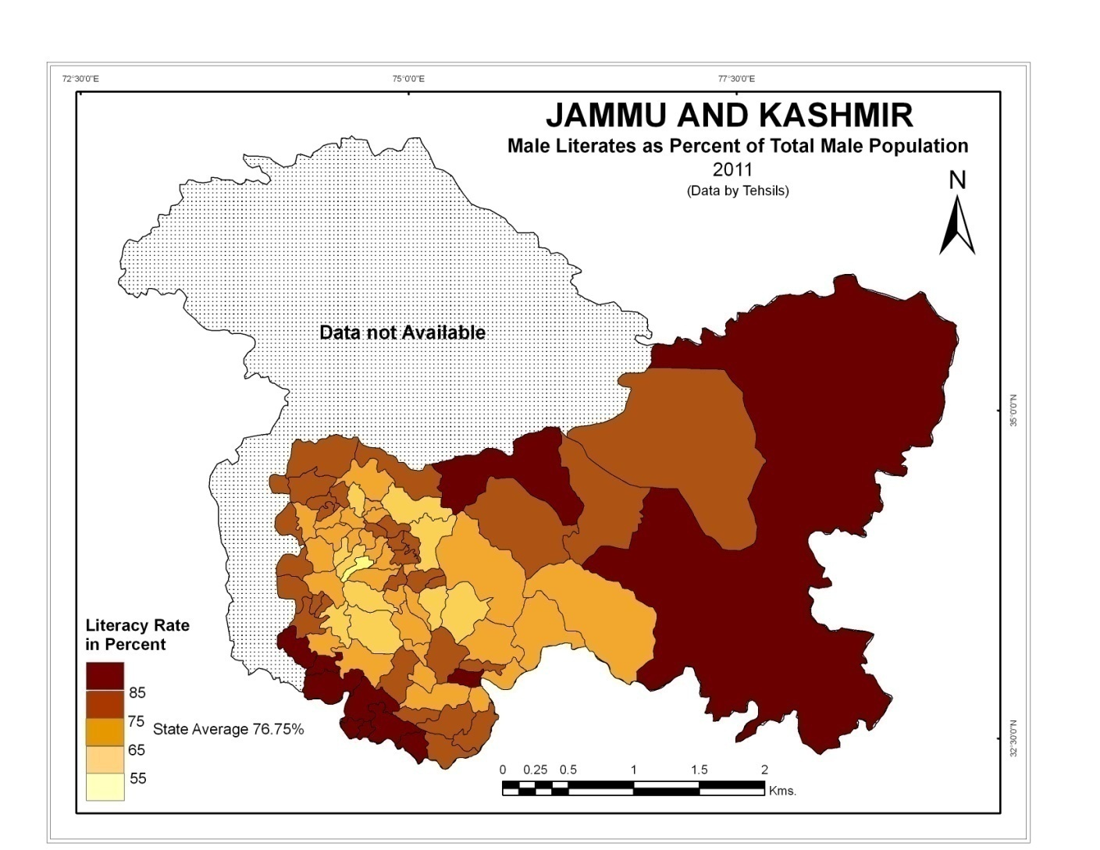

Slide 15
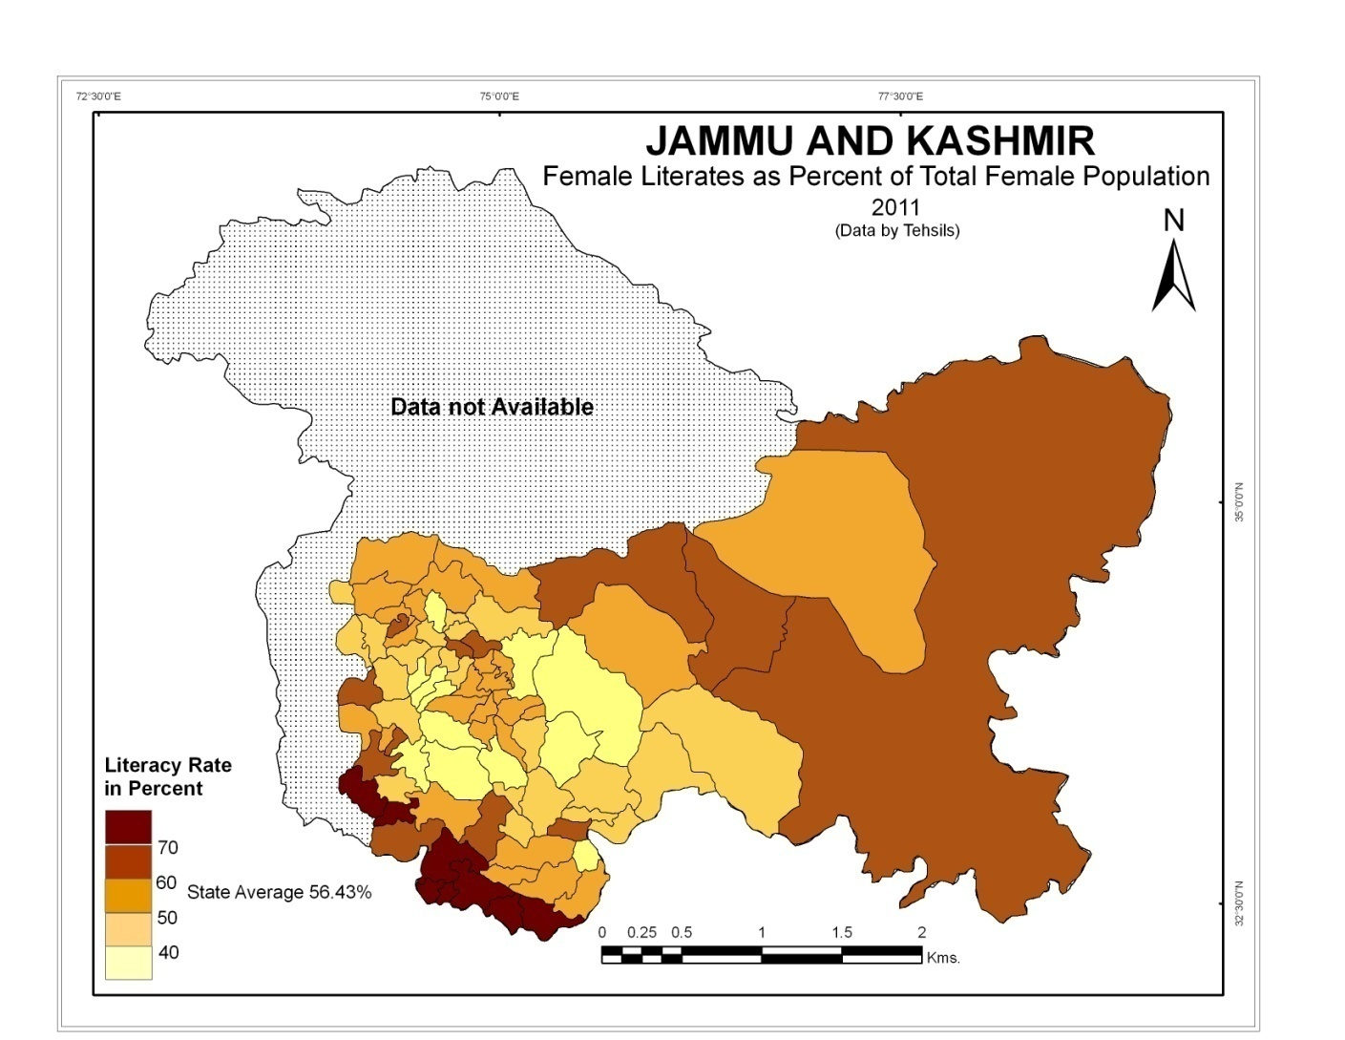

Slide 16
Urban-Rural Literacy
Jammu and Kashmir, being one of the least literate states in the country have sharp differences in the literacy rates of urban and rural population in 2011.
While in urban areas 77.12 percent people were able to read and write, this percentage was very low (63.18 percent) in rural areas.
These differences in urban and rural literacy were the outcome of differences in the society and economy of the two areas.
As per 2011 census, Jammu and Kashmir was a rural state with high proportion of rural population. Out of total number of 82 tehsils in all the 22 districts of the state, 60 tehsils had urban Settlement in some areas.
There was not even a single tehsils in the state with high rural literacy than the urban literacy in 2011.
Interestingly, the female literacy of urban areas (69.0 percent) was higher than even the general literacy (63.18 percent) of the rural population.
In 2011, the urban - rural literacy differential index in Jammu and Kashmir was 18.07.

Slide 17
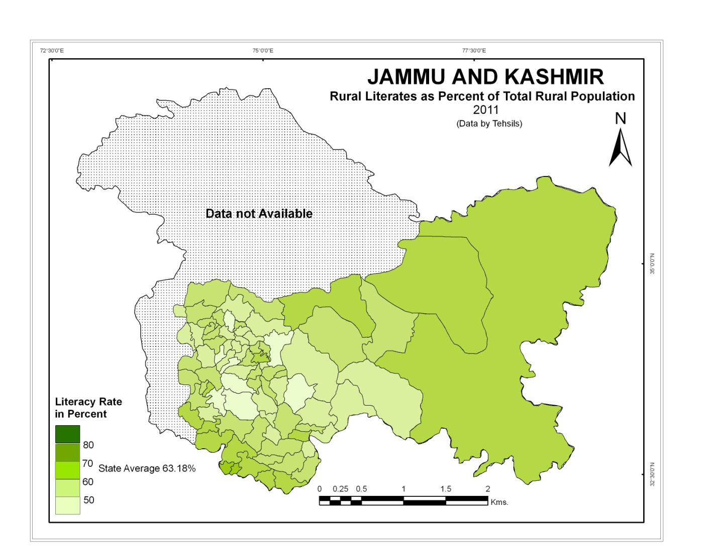

Slide 18
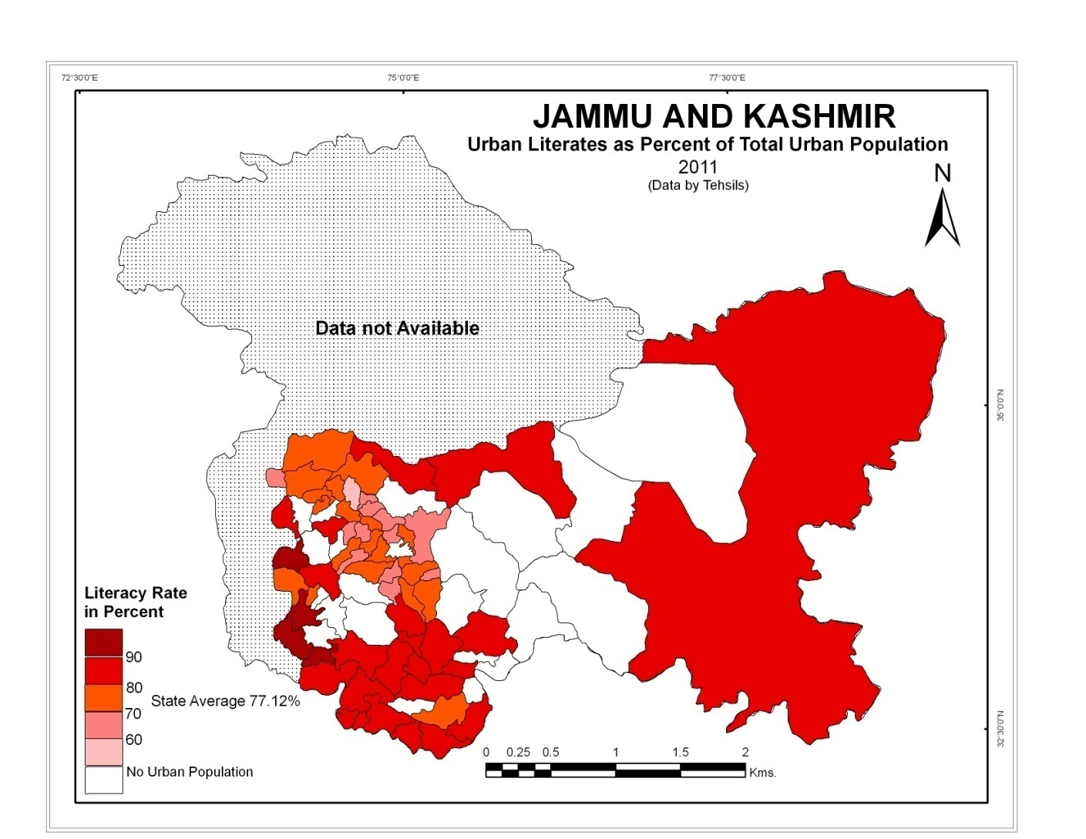

Slide 19
Areas with narrow rural-urban gap are those where moderate to low urban literacy and high rural literacy rates are found.
These areas are well connected to neighboring areas and the rural population is well exposed to the external influences.
In highly industrialized and urbanized areas of Jammu region, the spread effect of big towns and diffusion of literacy from urban to rural areas have reduced urban - rural differential in literacy.
The areas with moderate differential in rural - urban literacy are those which have displayed moderate to high literacy in urban areas and high literacy in rural areas. These areas have good rural economy.
High differential in rural-urban literacy are associated with areas showing high urban literacy and low rural literacy rates
High urban literacy is associated with status of district headquarters of towns and other urban centers.
Low rural literacy is associated with high proportion of Scheduled population in rural areas.
Agricultural base of rural society and low female literacy.
Low diffusion of literacy from urban to rural areas resulted in high differential in rural-urban literacy.

Slide 20
SCHEDULED TRIBE LITERACY
The Scheduled Tribes since ages have been different from the main land society with a distinct language, social organization, culture, economy, habitat, cultivation and food habits.
They have habitat of their own in the river valleys, hilly and forest regions and are suffering from isolation and neglect, which inflected considerable deprivation and poverty upon them.
Literacy is very low among Scheduled Tribe population in comparison to other social groups.
The literacy rate of Scheduled Tribes was 50.56 percent as against the national average of 58.95 percent in total population .
For the analysis of spatial patterns and differentials of literacy, only those tehsils have been taken into account where tribal population was more than one percent.
Hence, out of 82 tehsils only 74 tehsils have been found with a significant ST proportion.

Slide 21
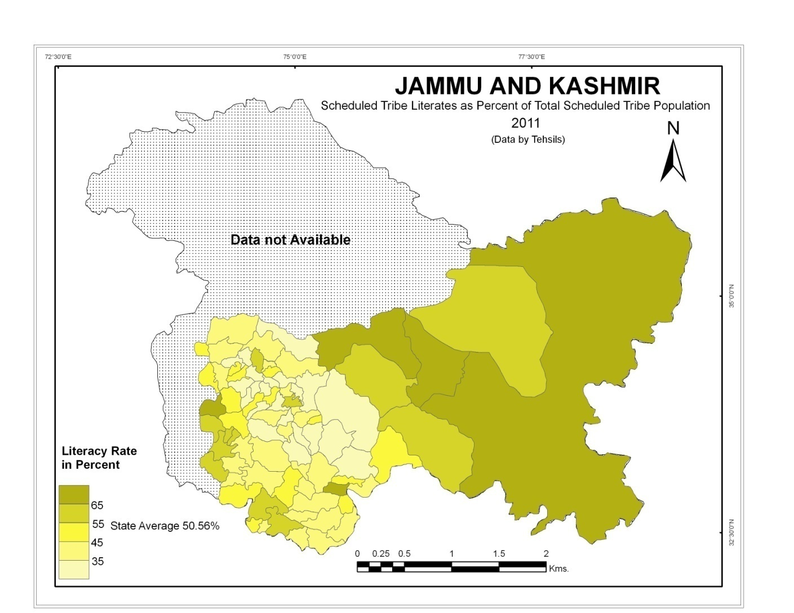

Slide 22
While 69.28 percent of the non-tribal population in the state is recorded as literate, the corresponding figure for the tribal population is only 50.56 percent.
The majority of tribal population in J&K lives in rural areas of difficult terrain and suffers from physical isolation.
Secondly, the tribal people speak many languages which impede interaction.
Thirdly, the present system of education is largely unsuitable to their life and ideals.
Fourthly, for fear of cultural disintegration also, the tribal population willfully keeps itself away from the rest of population.
Lastly, poverty and general ignorance about utility of education are the salient features of tribal society.

Slide 23
LITERACY IN SCHEDULED CASTE POPULATION
Scheduled Castes constitute an important segment of the social fabric of the state.
Seven districts i.e. Samba (28.80 percent), Udhampur (24.97 percent), Jammu (24.71 percent), Kathua (22.91 percent), Doda (13.03 percent), Reasi (12.0 percent) and Rajouri (7.50 percent) have larger proportion of Scheduled Caste population than the state average of 7.36 percent.
Two districts namely Kishtwar (6.2 percent) and Ramban (4.91 percent) had a proportion of Scheduled Caste population which was less than the state average.
The rest of the thirteen districts, i.e. Kupwara, Badgam, Leh, Kargil, Poonch, Baramulla, Bandipora, Srinagar, Ganderbal, Pulwama, Shupiyan, Anantnag, Kulgam had an extremely low proportion i.e. less than one percent of Scheduled Caste population to total population.

Slide 24
Jammu and Kashmir displayed relatively higher literacy levels among Scheduled Castes (70.16 percent) as compared to the national average (66.07 percent) in 2011.
The main reason behind the higher literacy rate among Scheduled Castes is the large concentration of Scheduled Caste population in more developed parts of the state where overall literacy rate was more than 75 percent.
Since independence a number of steps have been taken by the state as well as central government to strength the education and literacy of the Scheduled Caste population.
The opening of educational institutions in areas predominantly inhabited by Scheduled Castes, mid-day meals, free uniforms, incentives like scholarships, books and stationary have contributed, a lot in raising the level of education of Scheduled Caste population.

Slide 25
The reservation package in services and other sectors have promoted literacy and raise the level of education among Scheduled Castes.
The financial assistance in the form of margin money, direct loan on concessional rate of interest, poverty alleviation programmers' like IRDP, infrastructure support training in different skills have also raised the level of literacy in Scheduled Caste population.
The schemes and programmers' for the welfare of Scheduled Castes like overseas scholarships, self employment schemes, Rajiv Gandhi national fellowship, Pardhan Mantri Adarsh Gram Yojana, Babu Jagjivan Ram Chhatrawas Yojana, free coaching, Scheduled Castes finance and development corporation have also made their contribution in raising the level of literacy in Scheduled Caste population.

Slide 26
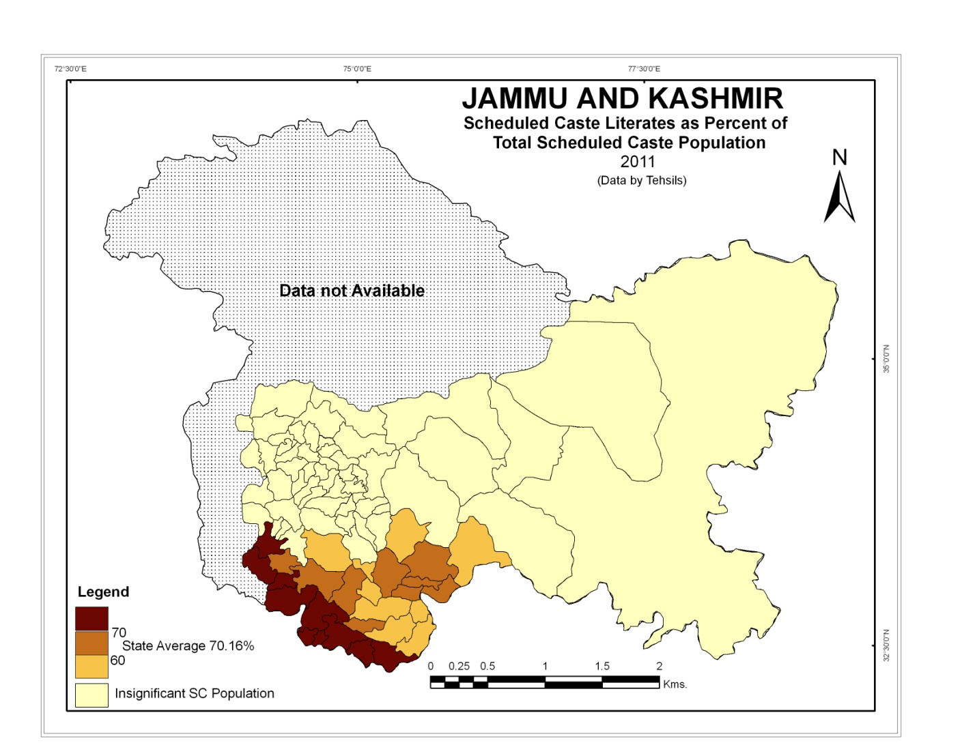

Slide 27
The Scheduled Caste population accounting for only 7.38 percent of the state’s population constituted highly literate segment among all social groups.
While 66.91 percent of Non-Scheduled Caste population in the state was recorded as literate, the corresponding figure for the Scheduled Caste population was 70.16 percent. It implied a differential index of – 4.8 in the state.
Out of the selected 28 tehsils, there were 25 tehsils which had differential index value more than the state average.
High level of literacy among Scheduled Caste population was positively correlated (+0.89) with their urban proportion.
The spatial patterns of differential index were inversely correlated (-0.25) to the spatial patterns of literacy among Scheduled Caste population.

Slide 28
CONCLUSIONS AND SUGGESTIONS
Wide disparities existed in literacy in different parts of the state. Male-female and urban-rural population too showed marked differences in levels attained.
Females(56.4 percent), rural population (63.1 percent)and Scheduled Tribes(50.5 percent) lagged far behind in literacy accomplishments.
Such wide ranging inequalities in literacy rates are broadly the product of (i) physiographic setup of the state (ii) the degree of accessibility to the educational institutions (iii) the nature of occupational structure (iii) the proportion of urban population (iv) the long history of turmoil.
Another feature of development of literacy in Jammu and Kashmir had been that the extent of increase in urban literacy(31.56) could not match the increase in rural literacy(41.55). Similarly increase in male literacy could not match the increase in female literacy.
Nature of physical setup has played an important role in determining the spatial patterns of literacy.
The low lying areas with early start of education and high composition of urban population had displayed a high literacy rate.

Slide 29
Variations in educational facilities, socio-economic conditions, degree of urbanization, connectivity and occupational structure as evolved over time and space also determined the patterns of literacy to a large extent.
In Jammu and Kashmir, high literacy level is found in eastern and south-western parts of the state.
Moderate and low literacy levels are found in the central mountainous and sub-mountainous regions of the state.
Jammu and Kashmir state has yet to go a long way to bridge the gap between male(76.7 percent) literacy. and female(56.3 percent) literacy.
Spatially, there are large regional variations in rural and urban literacy which further led to rural-urban differential in literacy.
Broadly speaking, patterns of rural literacy have large resemblance with those of overall literacy rates.
The differential in literacy between urban and rural areas is the result of the magnitude of diffusion of literacy from urban to rural areas, the attraction of urban centre and rural-urban interaction.

Slide 30
In 2011, only about half of the Scheduled Tribe(50.5 percent) population in Jammu and Kashmir was literate.
The mass illiteracy among Scheduled Tribes was related to their long history of socio-economic and physical isolation, age old association with primitive type of occupation.
The Scheduled Caste population recorded a literacy rate of 70.16 percent and was ahead from the rest of society in term of literacy.
The high concentration of Scheduled Caste population in highly urbanized areas and number of steps and schemes taken by the state as well as the central government to strengthen the education played a vital role in uplifting the social, economic and educational level of Scheduled Caste population.

Slide 31
FEW SUGGESTIONS FOR IMPROVEMRENT IN LITERACY
Education policies and schemes should be made on the basis of the location of the schools.
Primary and middle schools should be within the radius of 1KM in the villages.
Scholarship for the wards of the people lying below poverty line should be increased with increasing trends of inflation.
Provision of basic amenities like pure drinking water, electricity within the school.
Provision of proper infrastructure of the schools like spacious classrooms, proper sitting arrangements, separate toilets, playgrounds etc.
Provision of proper recreational activities in the schools. Proper arrangement of these activities will attract more children to school.
Proper awareness among students regarding the benefits of education and draw backs of illiteracy

Slide 32
Sensitizing parents regarding the benefits of educations. Maximum of the village parents do not know the benefit of education in long run
Spreading awareness about education among village masses by religious/other influential heads. Religious heads can be used effectively to spread the awareness among masses.
Proactive role of Panchayats in the improvement of education scenario of the villages. It has been observed that the areas where the panchayats are playing the active role in the spread of education have seen high literacy rates.
Provision of awards by the state and central governments for the villages that have attained certain level of literacy. This will encourage and will create a sense of competition among the village masses.
Improving teacher student ratio in the schools
Proper monitoring of the attendance of the teachers in the village schools and regular analysis of the progress they have made. Biometric system can be used for the proper attendance monitoring.

Slide 33
Mandatory refresher and orientation courses for the teachers on regular basis.
Imparting education in the local language of a particular area. Students can’t understand the alien language.
Proper implementation of mobile school initiative for the children of tribal people. The sections of the tribal's which are provided with the effective mobile schools have shown improvement of literacy rate.
Vocational training for the school dropout children and the unskilled/illiterate adults. This can create the essence of education among masses and also help them to earn their livelihood.
Most of the tribals being from conservative societies have several apprehensions about the schooling of their daughters. If their concerns are addressed properly, it would be helpful in increasing their literacy rate.
Strictly using tribal language as a mode of communication in the mobile schools.

Slide 34
Thank You

